Slide 1

Hotel Rating Classification
Natural Language Processing Project

Slide 2
TEAM INFO
Shaik Mujahid Shariff
Mohd Ariz Khan
Siddharth Kumar Sharma
G Sreeram Satya
Sairam Ramasamy
Anshu Pyasi
Niranjan Reddy

Slide 3
Problem Overview
Understanding the factors that influence hotel selection: The hotel industry is highly competitive, and it's essential to understand what factors impact a traveler's decision to choose a specific hotel.
Improving hotel brand image: The manager's objective is to understand which elements of their hotel influence more in forming a positive review and improve their hotel's brand image.
Classification of hotel ratings: The manager wants to classify hotel ratings based on the attributes that travelers consider while selecting a hotel.
Addressing travelers' needs and preferences: By identifying the critical factors that travelers consider while choosing a hotel, the manager can address their needs and preferences better, leading to improved ratings and a positive brand image.

Slide 4
OBJECTIVES
To understand the factors that influence hotel selection by travelers.
To analyze the attributes that travelers consider while choosing a hotel.
To identify how these attributes impact hotel ratings.
To provide insights into how the manager can improve their hotel's brand image.
To understand the elements of the hotel that positively impact forming a positive review.
To provide the manager with information to make informed decisions to enhance the hotel's reputation and attract more customers.

Slide 5
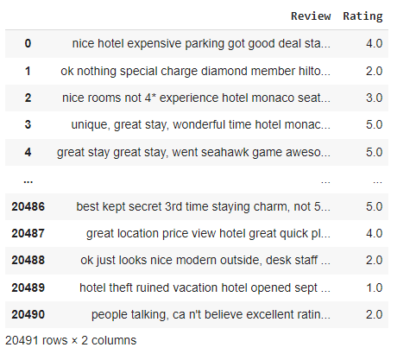
DATA DESCRIPTION
Source of data is in csv format.
Dataset contains 20491 rows and 2 columns.
There is no missing values in the dataset given to us.
There is no duplicate values in the dataset.
Datatype for:
‘Review’ is object
‘Rating’ is float

Slide 6
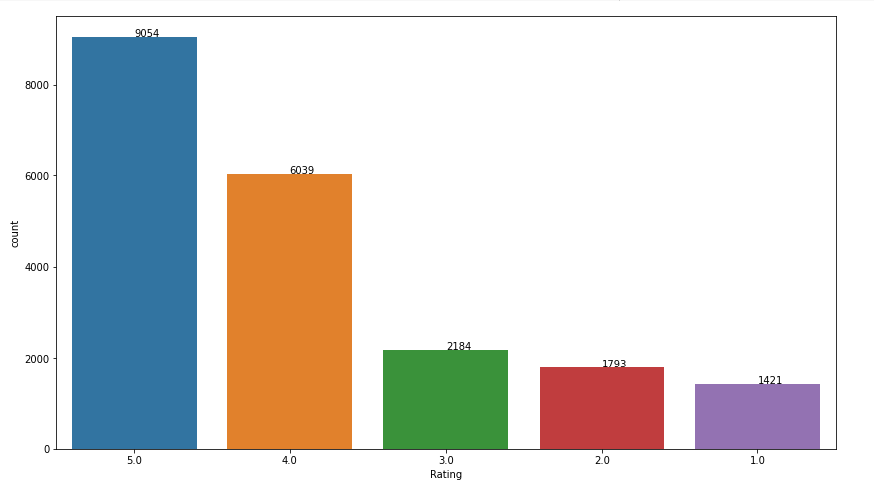
PERFORM EXPLORATORY DATA ANALYSIS
Bar Plot
From above visuals, we can say thatcount of ratings for 4, 5 are comparatively much higher than the other rating scores(3,2,1).
Hence, from our data we can say the atmost of the guests are highly satisfied with their experience at
hotels.

Slide 7
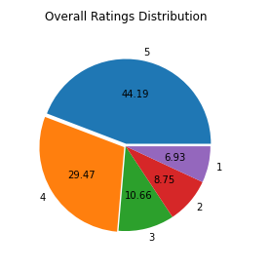
Pie Chart
From above visuals, we can say that almost 75% of reviews are rated (5, 4) by guests and remaining 25% reviews are rated
(3,2,1).
We have an unequal distribution of data, where we have less no. of negative ratings provided by guests.
Hence, our dataset is highly imbalanced dataset.

Slide 8
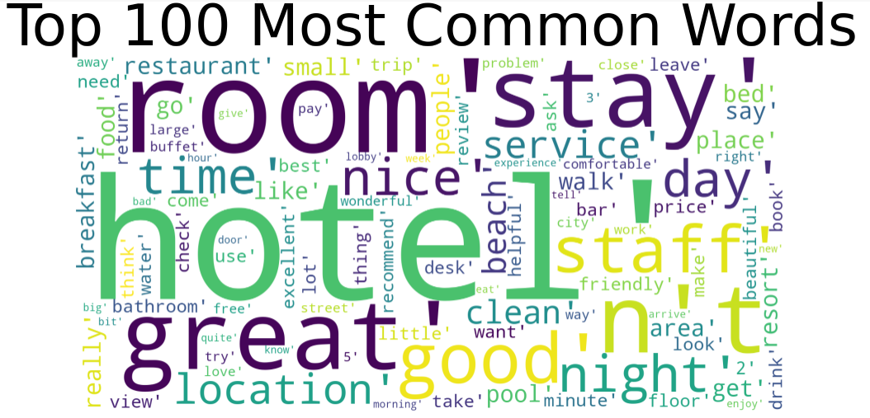
Word Cloud
It’s a data visualization technique used for
representing text data in which size of each word indicates its frequency or importance.

Slide 9
Text-Preprocessing
To begin with this process, first we remove tab spaces.
Remove contraction is a word made by shortening and combining two words. Words like can't (can + not), don't (do + not), and I've (I + have) are all contractions.
Tokenization through this we have gathered data and breaked them into understandable parts.
Lower Casing covert all text in lower case.
Remove punctuations and numerical data.
Remove Stopwords.
Lemmatization process of reducing the different forms of a word to one single form, for example, reducing "builds", "building", or "built" to the lemma "build“.

Slide 10
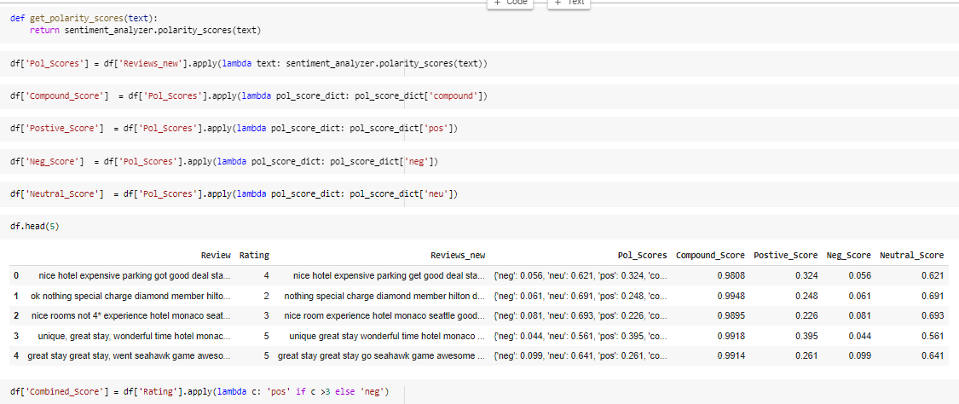

Sentimental Analysis
An approach to natural language processing that identifies the emotional tone behind a body of text. To determine and categorize opinions about reviews.

Slide 11
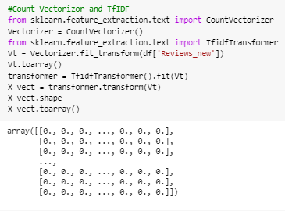
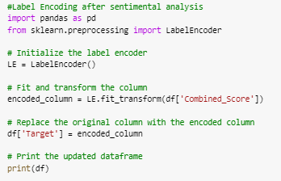
Vectorization
The process of converting or transforming a data set into a set of Vectors is called Vectorization.

Slide 12
Model Evaluation
Here we have applied the following Models:
Naive Bayes Model
Logistic Regression Model
Decision Tree
Random Forest
Gradient Boosting
Ada Boost
XG Boost
SVM
KNN

Slide 13
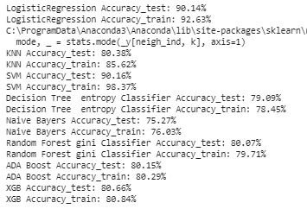
Selecting the best Model
In this classification model we have created different models using ML Algorithms to measure the performance of the model that gives us best accuracy rate to predict the data. As we have the performance results with us for the models, we will select the best one out of them which suits for our business models and predicts correctly.
Logistic Regression suits best for our model and gives the perfect prediction.

Slide 14
Model Deployment using Logistic Regression
Now that we have calculated accuracy score for all the models, we will select the best model i.e. logistic Regression to deploy our model locally and globally.

Slide 15

Model Deployment – Locally - Part - 1
Before we deploy our model, we need to load our model in our pickle format from where streamlit will run our main python file.
We use the below code to prepare the .pkl file and save it in our path.
Preparing the python file with our parameters(with all our prediction variables)
Saving the .py and .pkl file in our path so that we can run them locally.
We can deploy the model using anaconda prompt > create a virtual environment > create a folder to store our data files> run that folder using streamlit command.

Slide 16
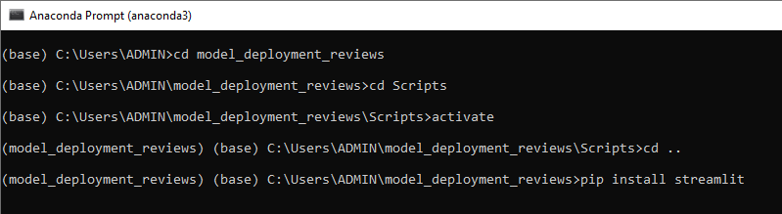
Model Deployment – Locally - Part - 2
Create a virtual environment and data folder in your local disk.
Run the model using streamlit (i.e. streamlit run Hotel_review.py). Which will create a local page (http://localhost:8501/)

Slide 17
Model Deployment – Globally – Part - 1
Here we will deploy our model globally, using GitHub and streamlit.
Below are the steps to follow :
Create a GitHub Account
Upload your data files in GitHub by creating a repository
Upload an additional file named requirements.txt, here you will need to add our libraries that will be required to run your file.
Open streamlit web page > share.streamlit.io
Open/Link your Github account with Streamlit account
Run streamlit/Deploy options to run the data file

Slide 18
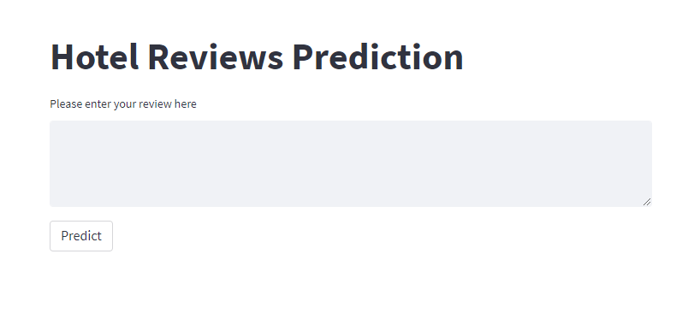
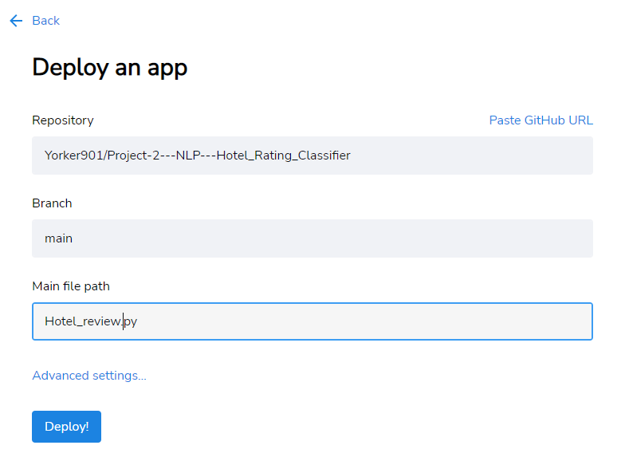
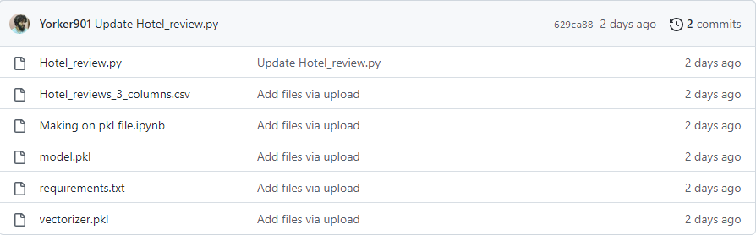
Model Deployment – Globally – Part - 2
Once you successfully select the repository>give the branch> .py file for model deployment.
Click Deploy > Your model is successfully deployed.
Model Deployment Link –> Access Hotel Rating Classifier

Slide 19
Challenges Faced
Data Availability: Finding enough relevant and accurate data to support the analysis and findings was challenging.
Data Quality: Ensuring the quality of data collected and making sure it is reliable and unbiased.
Data Analysis: Selecting the appropriate method for data analysis and making sure the results are statistically significant.
Visualization: Presenting the data and findings in an effective and easily understandable manner using visualizations.
Actionable Recommendations: Making recommendations based on the analysis that are practical, implementable, and have a significant impact on the hotel's rating.

Slide 20
Conclusion
Machine Learning can be used to identify positive and negative reviews correctly. However, identify with 100% confidence is impossible.
My final model cab be used for any hotel to find feature importance.
Word clouds cab be used to understand what words appear the most in positive and negative reviews.
The management can quickly take a look and get insights out of it.

Slide 21
THANK YOU

